Slide 1
QUICK RESPONSE (QR) CODE ATTENDANCE SYSTEM (CASE STUDY COMPUTER SCIENCE DEPARTMENT) BY UKO WISDOM MODEY (ST/CS/HND/21/090) BEING A PROJECT PROPOSAL SUBMITTED TO THE DEPARTMENT OF COMPUTER SCIENCE, SCHOOL OF SCIENCE AND TECHNOLOGY, FEDERAL POLYTECHNIC, MUBI, ADAMAWA STATE. IN PARTIAL FULFILMENT OF THE REQUIREMENTS FOR THE AWARD OF HIGHER NATIONAL DIPLOMA (HND) IN COMPUTER SCIENCE. PROJECT SUPERVISOR: MR. KASSIM MUSTAPHA JULY, 2023

Slide 2
BACKGROUND TO THE STUDY
Attendance monitoring of students in institution can be rigorous using the conventional method of paper sheets and old file system method. Every academic institution poses some standards concerning how attendance is to be confirmed for student in classes, laboratory sessions and examination halls.
QR code-based attendance monitoring systems offer several advantages over traditional methods. They eliminate the need for manual data entry and provide real-time access to attendance data. These systems also enhance security by reducing the risk of unauthorized access or tampering with attendance records.

Slide 3
PROBLEM STATEMENT
Time-consuming: Manual attendance tracking methods are often labor-intensive, requiring staff members to manage registers or sign-in sheets, which can be time-consuming and prone to errors.
Inaccuracy: Manual systems are susceptible to human error, such as misinterpretation of handwriting or accidental omissions, leading to inaccuracies in attendance records.
Lack of real-time data: Traditional systems do not provide real-time attendance data, making it difficult for institutions to track attendance trends or identify patterns in attendance behavior.

Slide 4
AIM AND OBJECTIVES
The aim of this project is to develop a Quick Response (QR) Code Attendance system for monitoring and taking of student attendance. The objectives are listed as below:
To store, access and manage student attendance data for every lecture taken.
To develop a system where all student attendance data will be stored and managed.
To develop a system that will be saving attendance records into the system will be more secured as compared to paper-based records.

Slide 5
DISADVANTAGES OF EXISTING SYSTEM
The existing system involves a tedious process and it is time consuming.
The result of calculation might go wrong when lecturer missed out some of the data in the attendance record.
In addition, lecturer needs to manually write all the details about the attendance data to the appropriate documents when needed.

Slide 6
ADVANTAGES OF PROPOSED SYSTEM
The following are the advantages of an Attendance Monitoring system. They include the following:
Accuracy of student attendance.
Reduce cost of materials usage such as papers and pens.
Productivity / Efficiency: The time and effort saved combined with data accuracy helps in optimizing the use of resources which lead to increased productivity and improves profits.
Hassle Free Workflow Management
Real-time tracking
Security and up to date record.

Slide 7
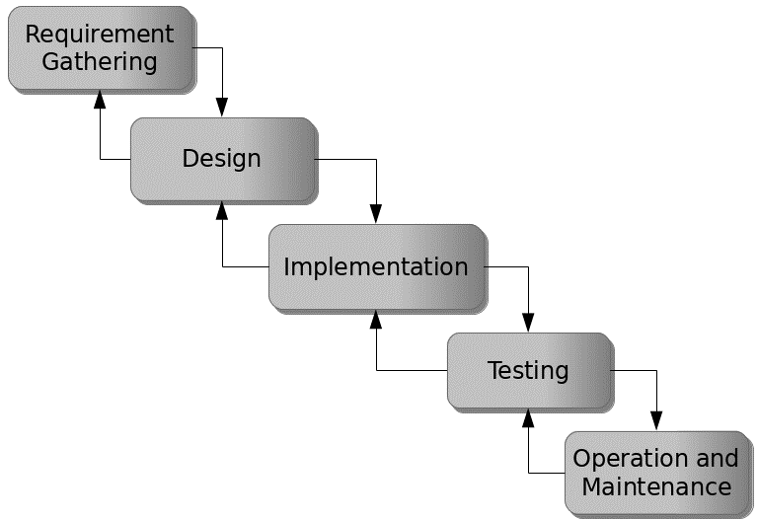
PROPOSED METHOD
The waterfall model is a traditional sequential approach to software development that consists of distinct phases that follow a linear sequence. Figure 3.1 below is a simplified version of the waterfall model for the proposed Attendance Monitoring System using QR code.
Figure 3.1: Waterfall model

Slide 8
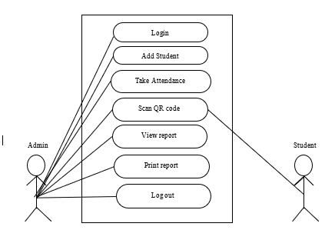
UML ALGORITHM
Use case diagram

Slide 9
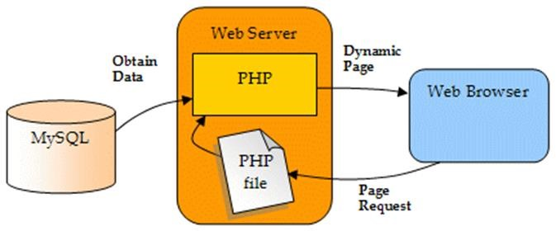
SYSTEM ARCHITECTURE

Slide 10
REFERENCES
Andrew, A. (2011). PsychVACS: A system for asynchronous telepsychiatry. Telemedicine Journal and e-Health, 17, 299–303.
Bhushan, B., & Kumari, P. (2020). Applications of QR code technology in education: A review. International Journal of Advanced Research in Computer Science, 11(2), 167-174.
Butler, E. (2017). Provider barriers to telemental health: obstacles overcome, obstacles remaining. Telemedicine Journal and e-Health, 19, 433–437.
Castella-Roca, N., Herrera-Joancomarti, M. & Dorca-Josa, D. (2006). Finding a depression app: A review and content analysis of the depression app marketplace. JMIR Mhealth Uhealth,, 3(16).
Chai, W. K., Loo, J., Lau, R. Y., & Sintoris, C. (2017). QR code technology: An exploratory study of applications, benefits, and challenges. Journal of Systems and Information Technology, 19(4), 375-392.
Chai, W. K., Loo, J., Lau, R. Y., & Sintoris, C. (2017). QR code technology: An exploratory study of applications, benefits, and challenges. Journal of Systems and Information Technology, 19(4), 375-392.

Slide 11
THANKS FOR LISTENING

